Slide 1
Contactless Vending Machine.
Team Members: Team Name:
Ranganath ContactlessVend
Vijay
Aravind

Slide 2
Problem:
A Normal Vending Machine will requires the user interaction(contact with machine)like selecting items through machine display/keypad and providing cash to the machine which in turns returns the items to consumer. In this pandemic situation the contact with machine will not be safe.

Slide 3
Solution:
Using contactless and cashless purchase from the vending machine through any QR or URLs placed on the vending machine. After scanning or entering URL in portable devices(mobiles) will navigate the consumers to select and the items, make payment and trigger an event to push back the item from the machine to consumer.

Slide 4
Implementation:
Software
For Contactless Vending machine developed two Modules.
User Interface for portable devices with third party online payment being integrated.
A web page to display functionality of Vending Machine(virtual Vending machine).
Hardware
Arduino chips for accepting user input and motors to dispense items.

Slide 5
Technologies:
Nodejs.
WebSocket.
HTML,CSS,JS,AJAX.
Azure cloud
C language in Arduino.

Slide 6
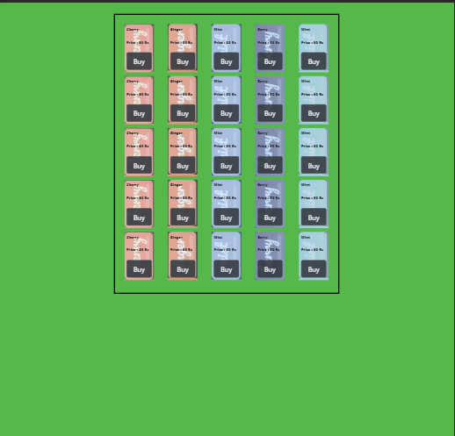
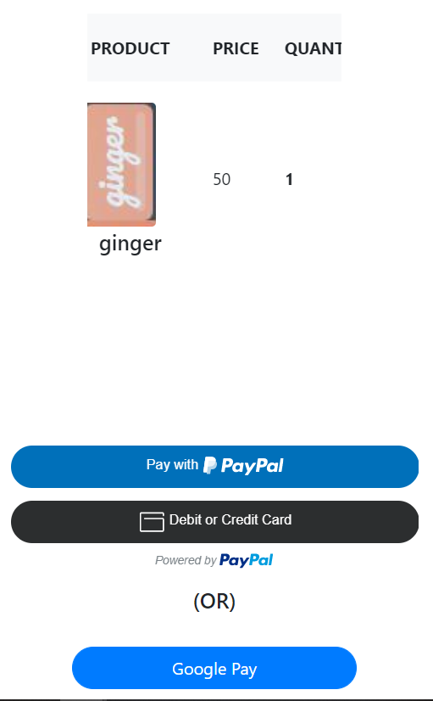
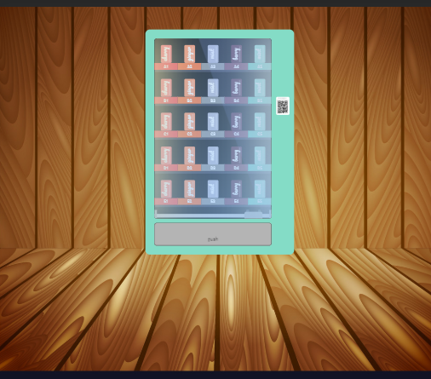
Output Screens(software):

Slide 7
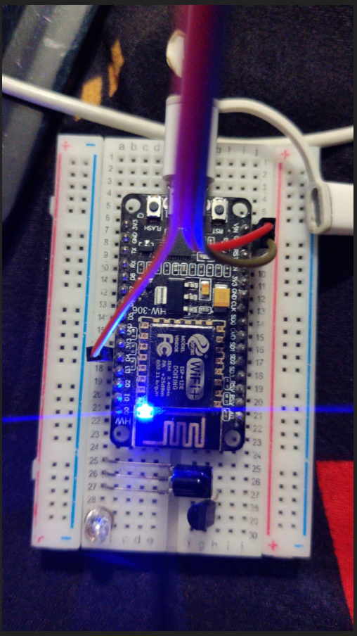
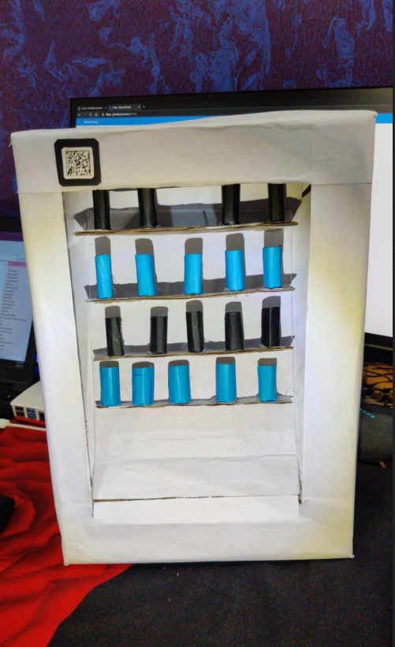
Output Screens(Hardware):

Slide 8
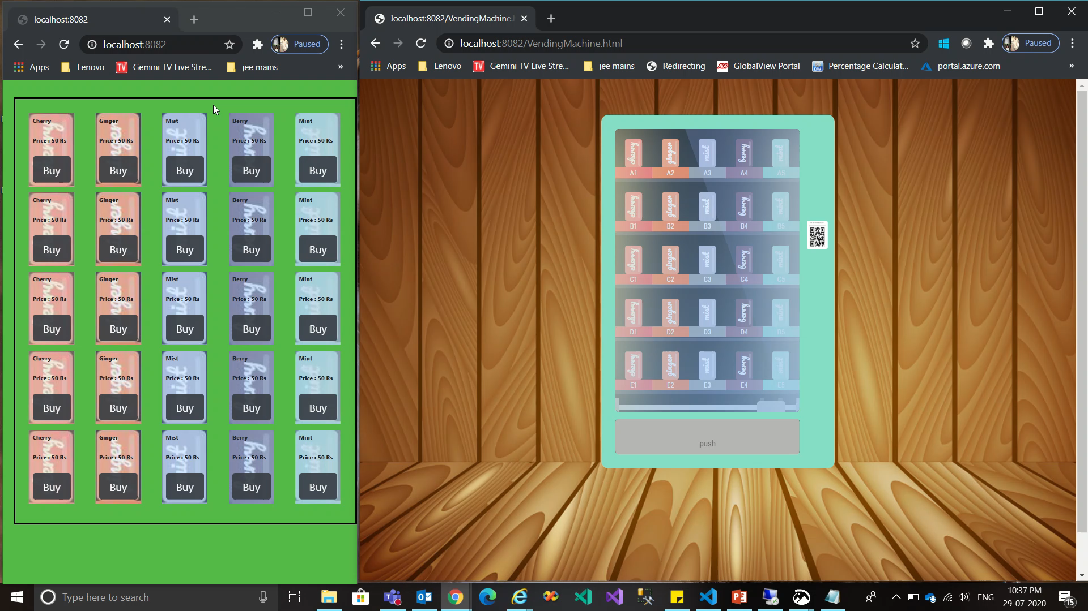
Output Video:

Slide 9
THANK YOU

